Slide 1
Generating the AES S-box and Performing a Linear Analysis
Presentation by Adam Hayse
CS 492 – Computer Security
26 April 2017

Slide 2
Summary
Advanced Encryption Standard (AES) Overview
Define Finite Fields (Galois Fields)
Arithmetic in Finite Fields
Computing the Inverse by Hand
Demonstration

Slide 3
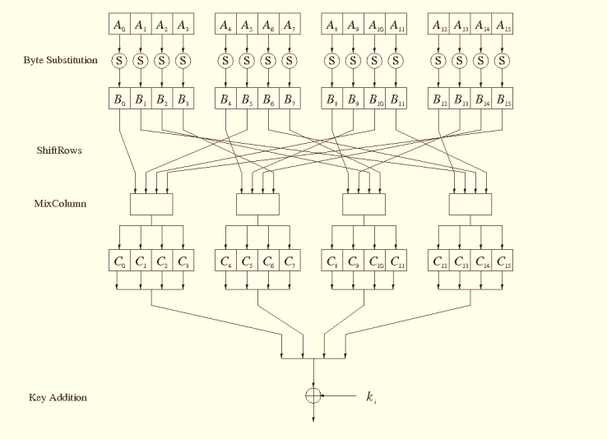
128-bit AES Round Function
Notes:
Here is a diagram of the AES round function. There are 16 S-boxes that each map 8 bits to 8 bits. The input 8-bits is the 8-bit subkey XOR’d with the 8-bit plaintext. The S-box is the only non-linear component of the round function. Even though the S-box is non-linear, a probabilistic attack can be performed by examining the known plaintext in order to increase the probability that you will be able to guess the key.

Slide 4
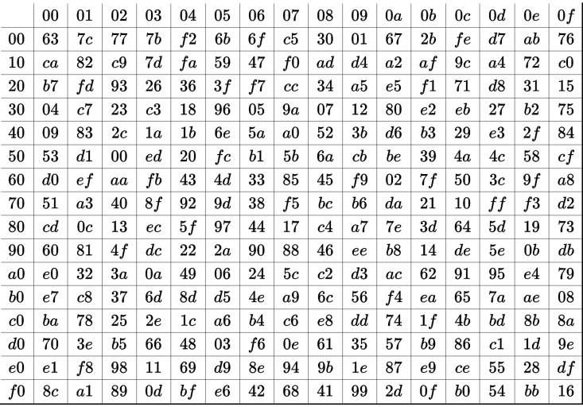
AES S-box
Notes:
This is a chart of the AES S-box. You can locate the input byte by looking at the left-most column and combining it with the top-most row. For example, the output value of 0x72 is 0x40.

Slide 5
Finite Fields
A field is a set of elements for which the four basic operations are closed within the set
Example: set of real numbers (ℝ)
Given a, b ∈ ℝ:
  a+b = c ∈ ℝ
  a-b = c ∈ ℝ
  a*b = c ∈ ℝ
  a/b = c ∈ ℝ
A finite field is a field that has a finite number of elements
Notes:
A field is a set of elements for which the four basic operations are closed within the set. A familiar example of a set with closure is the set of real numbers. You can perform any operation between two real numbers, addition, subtraction, multiplication, or division, and the result will always be a real number. The set of natural numbers is not closed under all four operations. For example, 1 minus 2 is -1, which isn’t in the set of natural numbers. A finite field is just a field that is finite.

Slide 6
Finite Fields
A finite field only exists if its size is p^{m}, where p is a prime number and m is a natural number
Two types of finite field:
  Prime field (m=1)
  Extension field (m>1)
Need to map 8 bits to 8 bits, so we are interested in the finite field GF(2⁸).
Notes:
A finite field can only be of size p to the m where p is a prime number and m is a natural number. I’m not going to explain why this is the case yet, but it will become obvious later on because it is related to something we have already done in class before. There are two types of finite field. Prime fields are of size p to the first power, and extension fields are of size p to a power greater than 1. For AES, we work in the extension field that contains 2 to the 8th elements.

Slide 7
Prime Field Arithmetic
Addition: (a + b) mod p
Subtraction: (a – b) mod p
Multiplication: (a * b) mod p
Division: (a * b⁻¹) mod p
Example: GF(5¹) = {0, 1, 2, 3, 4}
Notes:
First, I’ll talk about prime field arithmetic. This is very simple and we have seen things similar to this before. Since a prime field is of size p, we can simply do modular division using p to make sure that the result of each operation stays within the finite field, preserving closure. Division is done by performing multiplication with a number’s modular inverse. I show the finite field of size 5 as an example to clarify.

Slide 8
Prime Field Arithmetic
Addition:
Subtraction:
Multiplication:
 | 0 | 1 | 2 | 3 | 4
0 | (0+0) mod 5 | (0+1) mod 5 | (0+2) mod 5 | (0+3) mod 5 | (0+4) mod 5
1 |  | (1+1) mod 5 | (1+2) mod 5 | (1+3) mod 5 | (1+4) mod 5
2 |  |  | (2+2) mod 5 | (2+3) mod 5 | (2+4) mod 5
3 |  |  |  | (3+3) mod 5 | (3+4) mod 5
4 |  |  |  |  | (4+4) mod 5
 | 0 | 1 | 2 | 3 | 4
0 | 0 | 1 | 2 | 3 | 4
1 |  | 2 | 3 | 4 | 0
2 |  |  | 4 | 0 | 1
3 |  |  |  | 1 | 2
4 |  |  |  |  | 3
 | 0 | 1 | 2 | 3 | 4
0 | (0-0) mod 5 | (0-1) mod 5 | (0-2) mod 5 | (0-3) mod 5 | (0-4) mod 5
1 | (1-0) mod 5 | (1-1) mod 5 | (1-2) mod 5 | (1-3) mod 5 | (1-4) mod 5
2 | (2-0) mod 5 | (2-1) mod 5 | (2-2) mod 5 | (2-3) mod 5 | (2-4) mod 5
3 | (3-0) mod 5 | (3-1) mod 5 | (3-2) mod 5 | (3-3) mod 5 | (3-4) mod 5
4 | (4-0) mod 5 | (4-1) mod 5 | (4-2) mod 5 | (4-3) mod 5 | (4-4) mod 5
 | 0 | 1 | 2 | 3 | 4
0 | 0 | 4 | 3 | 2 | 1
1 | 1 | 0 | 4 | 3 | 2
2 | 2 | 1 | 0 | 4 | 3
3 | 3 | 2 | 1 | 0 | 4
4 | 4 | 3 | 2 | 1 | 0
 | 0 | 1 | 2 | 3 | 4
0
1 |  | (1*1) mod 5 | (1*2) mod 5 | (1*3) mod 5 | (1*4) mod 5
2 |  |  | (2*2) mod 5 | (2*3) mod 5 | (2*4) mod 5
3 |  |  |  | (3*3) mod 5 | (3*4) mod 5
4 |  |  |  |  | (4*4) mod 5
 | 0 | 1 | 2 | 3 | 4
0
1 |  | 1 | 2 | 3 | 4
2 |  |  | 4 | 1 | 3
3 |  |  |  | 4 | 2
4 |  |  |  |  | 1
Notes:
Since the finite field of size 5 is small, I show here all of the possible combinations of elements and operations and their results. The column of tables on the right is the same as the one to the left, but simplified to show that all of the results do in fact stay within the finite field.

Slide 9
Prime Field Arithmetic
1⁻¹ mod 5: 1
2⁻¹ mod 5: 5 = 2(2) + 1
1 = 5(1) – 2(2)
1 = 5(1) + 2(-2)
-2 mod 5 = 3
3⁻¹ mod 5: 5 = 3(1) + 2
3 = 2(1) + 1
1 = 3(1) – 2(1)
1 = 3(1) – (5 – 3)(1)
1 = 3(2) – 5(1)
2 mod 5 = 2
4⁻¹ mod 5: 5 = 4(1) + 1
1 = 5(1) – 4(1)
1 = 5(1) + 4(-1)
-1 mod 5 = 4
 | 1⁻¹ | 2⁻¹ | 3⁻¹ | 4⁻¹
1 | (1*1) mod 5 | (1*3) mod 5 | (1*2) mod 5 | (1*4) mod 5
2 |  | (2*3) mod 5 | (2*2) mod 5 | (2*4) mod 5
3 |  |  | (3*2) mod 5 | (3*4) mod 5
4 |  |  |  | (4*4) mod 5
 | 1⁻¹ | 2⁻¹ | 3⁻¹ | 4⁻¹
1 | 1 | 3 | 2 | 4
2 |  | 1 | 4 | 3
3 |  |  | 1 | 2
4 |  |  |  | 1
Notes:
Division is a little different. First, we need to find the modular inverse of each element. We do this by applying the extended euclidean algorithm. If you remember from one of our previous classes, we learned that modular inverse with two numbers that share a factor does not work because there is no way to get an expression like this to equal 1. This is the reason why finite fields can’t exist when the p of p to the m is not prime. Some of the elements within the multiplicative group will not have an inverse, which means you can’t perform division with them. This violates definition of a finite field that all 4 operations are supported.
As expected, if you look at the result in the table, all of the results fall within the finite field.

Slide 10

Extension Field GF(2^{m})
The elements of GF(2^{m}) for m > 1 are polynomials of the form:
  $$A\left(x\right)= a_{m−1}x^{m−1}+…+a_{1}x+a_{0}$$
The coefficients $a_{i}$ of each polynomial belong to the sub-field GF(2¹) = {0, 1}, which is a prime field.
Notes:
Extension fields is where things get strange, but there are still some familiar ideas that you may recognize as I discuss them. We’ve actually used finite field arithmetic in class before without realizing it. For AES, we need to look specifically at finite fields of size 2 to the m. The elements in fields of this form are polynomials. The coefficients of these polynomials are either one or zero.

Slide 11
Example: GF(2³)
GF(8) = {0, 1, x, x+1, x², x²+1, x²+x, x²+x+1}
x² | x | 1
0 | 0 | 0
0 | 0 | 1
0 | 1 | 0
0 | 1 | 1
1 | 0 | 0
1 | 0 | 1
1 | 1 | 0
1 | 1 | 1
0
1
x
x + 1
x²
x² + 1
x² + x
x² + x + 1
Notes:
Here is an example to clarify. This is the finite field of size 8 and the elements that belong to the set. These polynomial elements can be represented as 3 bit binary numbers like what you see in this table. This representation should be very intuitive to understand.

Slide 12

Addition and Subtraction in GF(2^{m})
$$A\left(x\right)=a_{m−1}x^{m−1}+ …+a_{1}x+a_{0}$$
$$B\left(x\right)=b_{m−1}x^{m−1}+ …+b_{1}x+a_{0}$$
$$A\left(x\right)±B\left(x\right)=\sum_{i=0}^{m−1}{(ai±bi mod 2)}$$
Add:
(x+1) + (x²+x) = x²+ (1+1)x + 1 = x²+ 1
011 + 110 = 101
Subtract:
(x+1) - (x²+x) = (0-1)x²+ (1-1)x + (0-1)1 = x²+ 1
011 - 110 = 101
Notes:
Now I’m going to demonstrate how arithmetic is performed on the elements in this field. Given the polynomials A and B, their sum is equal to the sum of the sums of their coefficients mod 2. This may be a little difficult to understand at first, but I provide an example here to demonstrate what this means. Here I am adding the two polynomials x plus 1 and x squared plus x. We get this following result. We get a 2x, but our coefficients belong to the prime field that has 2 elements, so it can only be a 0 or 1. This rule is enforced by performing modular division by 2, and the result is 0, so the term disappears and we are left with x squared plus 1. Looking at the subtraction, we get the same exact result. We get negative 1s in some of the coefficients, but this is okay because negative 1 mod 2 is equal to 1. This means that addition and subtraction in the finite field of size 2 to the m are the same operation. Also, if you look closely here, you might realize something interesting. The result of adding these two numbers is the same as performing an exclusive or between these two numbers, which is very important in the implementation of my program.

Slide 13
Multiplication in GF(2^{m})
If we try to simply multiply two polynomials in GF(8), we get something like this:
(x²+1)(x²+x) = x⁴ + x³ + x² + x
x⁴ + x³ + x² + x ∉ GF(2³)
The result is not in the field.
Need a polynomial that behaves like a prime number.
Notes:
Now let’s try multiplying two numbers in the finite field of 8 elements. Both of these polynomials are in the field, but their product isn’t. In prime fields, this was handled by dividing by a prime number. So, in order to resolve this problem, we need to use a polynomial that behaves like a prime number. This is called an irreducible polynomial.

Slide 14

Irreducible Polynomials
Irreducible polynomials cannot be factored
The degree of the polynomial used in GF(2^{m}) must be of degree m
There are usually many polynomials of degree m that fit these requirements
AES uses GF(2⁸) and the irreducible polynomial $P\left(x\right)=x^{8}+x^{4}+x^{3}+x+1$
The hexadecimal representation is 0x11b
Notes:
An irreducible polynomial cannot be factored and it must be of degree m. There are often many polynomials that fit these requirements. The AES S-box uses this polynomial here as its irreducible polynomial. However, there are 29 other irreducible polynomials of degree 8 that will all work just as well as this one.

Slide 15
Polynomial Modular Reduction
A degree 3 irreducible polynomial is x³ + x + 1
(x⁴ + x³ + x² + x ) : (x³ + x + 1) = x + 1
+x⁴ +x² +x
x³
+x³ +x +1
x + 1
11110
1011
---------
01000
1011
---------
0011
Notes:
Going back to the multiplication example, we see that we can use this polynomial here which happens to be irreducible. We reduce the product polynomial by aligning the irreducible polynomial with it and performing exclusive or. You should recognize this process here. The binary reduction and polynomial reduction do the exact same thing, but with different representations.

Slide 16
Extended Euclidean Algorithm for Polynomials
When applied to integers, the formula is:
a = bq + r, where q ∈ Z and 0 ≤ r < |b|
When applied to polynomials, the formula is similar:
A(x) = B(x)Q(x) + R(x)
where Q(x) is a polynomial such that
0 ≤ deg(R(x)) < deg(B(x))
Notes:
This is where it gets difficult. We need to now find the inverse of polynomials within the finite field. For prime fields, it was done by using the extended euclidean algorithm. We use the same algorithm on polynomials. In the extended euclidean algorithm for numbers, we are interested in finding a q and an r such that q is an integer and r is between 0 and b. For any two numbers a and b, the solutions to q and r will be unique, meaning that there is only one q and one r that satisfies this equation with the given restrictions. For polynomials, the same exact properties exist. We need to find a polynomial Q and polynomial R such that the degree of R is less than the degree of B. The solutions for Q and R will also be unique in this situation, but determining these values isn’t as easy to do as with numbers.

Slide 17

Linear Analysis

Slide 18
References
Paar, Christof. "Advanced Encryption Standard (AES)." YouTube. Web. 26 Mar. 2017. <https://www.youtube.com/watch?v=NHuibtoL_qk>.
Paar, Christof. "Introduction to Galois Fields for the AES." YouTube. Web. 26 Mar. 2017. <https://www.youtube.com/watch?v=x1v2tX4_dkQ>.
Stamp, Mark. Information security: principles and practice. Hoboken, NJ: Wiley, 2011. Print.
Daemen, Joan, and Vincent Rijmen. National Institute of Standards and Technology. N.p., 9 Mar. 1999. Web. 26 Mar. 2017. <http://csrc.nist.gov/archive/aes/rijndael/Rijndael-ammended.pdf#page=1>

